Slide 1


Phishing Email Awareness
Fatima Arooj Satti

Slide 2
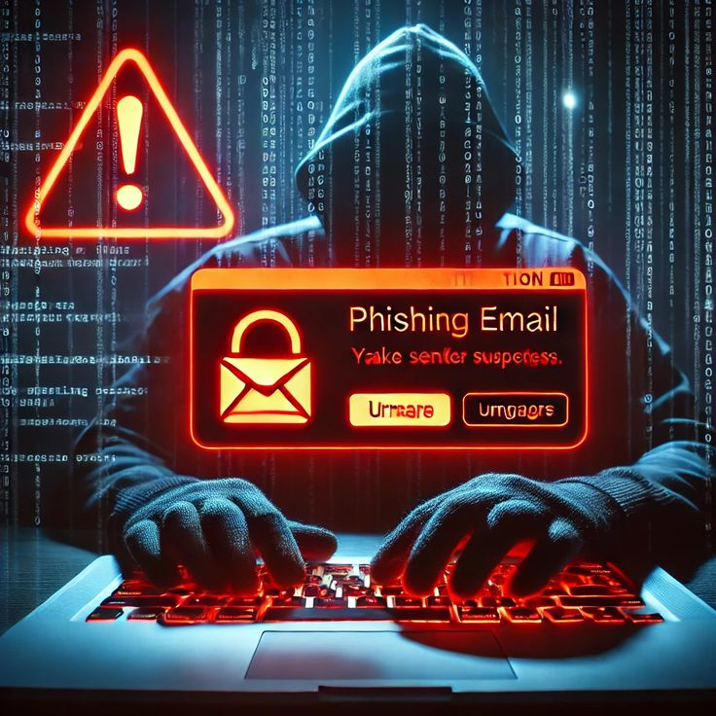
Phishing
Phishing is a cyber attack where attackers trick users into revealing sensitive information such as passwords, OTPs, and banking details through fake emails, websites, or messages.

Slide 3
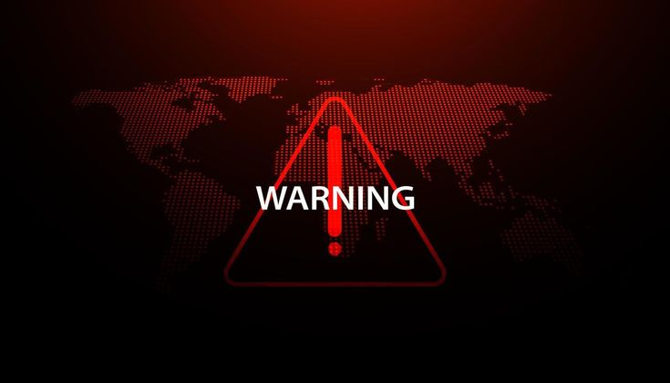
Signs of Phishing
Common Signs of Phishing:
• Urgent messages
• Suspicious links
• Fake login pages
• Spelling mistakes
• Unknown attachments

Slide 4
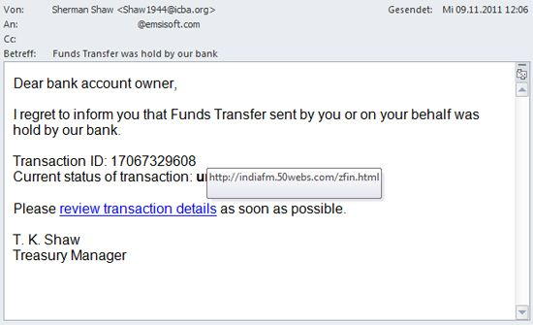
Real Example
Your bank account has been suspended. Click here immediately to verify your account."This message is dangerous because it tries to steal user credentials through fake websites.

Slide 5

Safety Tips
Never click unknown links
Verify sender email
Enable Two-Factor Authentication
Use antivirus software
Avoid downloading suspicious attachments

Slide 6
Thank you
Fatima Arooj Satti
Stay safe online!

